Slide 1
Computer Organization & Assembly Language
Lecture 03
by Omar Bin Samin

Slide 2
Today’s Discussion
Von Neumann Machine
Basic Computer’s Structure

Slide 3
The Von Neumann Machine
In 1946, Von Neumann and his colleagues began the design of a new stored program computer, referred as the Institute for Advanced Study (IAS) computer
It was able to store program in memory alongside the data. This idea is known as “Stored Program Concept”
Notes:
The IAS machine was the first electronic computer built at the Institute for Advanced Study (IAS), in Princeton, New Jersey, USA.

Slide 4
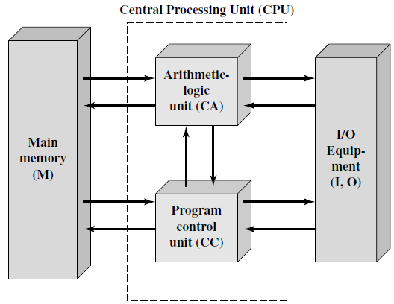
Structure of IAS Computer
Notes:
CA : Central Arithmetic
CC : Central Control

Slide 5
IAS computer consists of:
A main memory, for storing both data and instructions
An Arithmetic Logic Unit (CA), for performing arithmetic and logic operations. It operates on binary data
A Program Control Unit (CC), for interpreting the instructions and facilitating their execution
Input and Output (I/O) equipment operated by the control unit

Slide 6
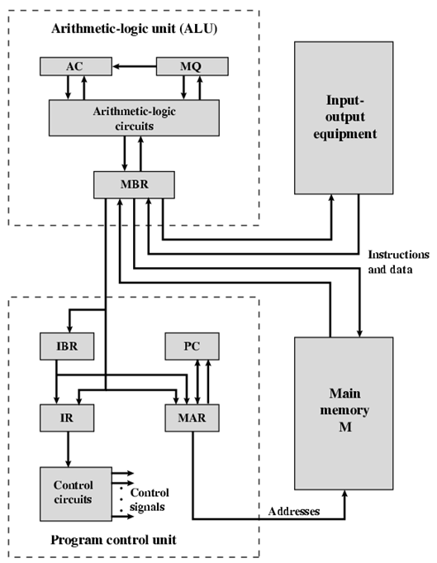
Expanded Structure of IAS Computer

Slide 7
The above figure reveals that both the Program Control Unit and the ALU contain storage locations, called registers, discussed as follows:
Memory Buffer Register (MBR): contains a word to be stored in memory or sent to the I/O unit, or is used to receive a word from memory or from the I/O unit
Memory Address Register (MAR): specifies the address of the word in memory, to be written from or read into the MBR

Slide 8
Program Counter (PC): contains the address of the next instruction to be fetched from memory
Accumulator (AC) and Multiplier Quotient (MQ): hold operands and results of ALU operations. For example, the result of multiplying two 64-bit numbers is 128-bit number; the most significant 64-bits are stored in the AC and the least significant 64-bits in the MQ
Instruction Register (IR): contains the 8-bit opcode of instruction being executed
Instruction Buffer Register (IBR): holds the instruction from a word in memory

Slide 9
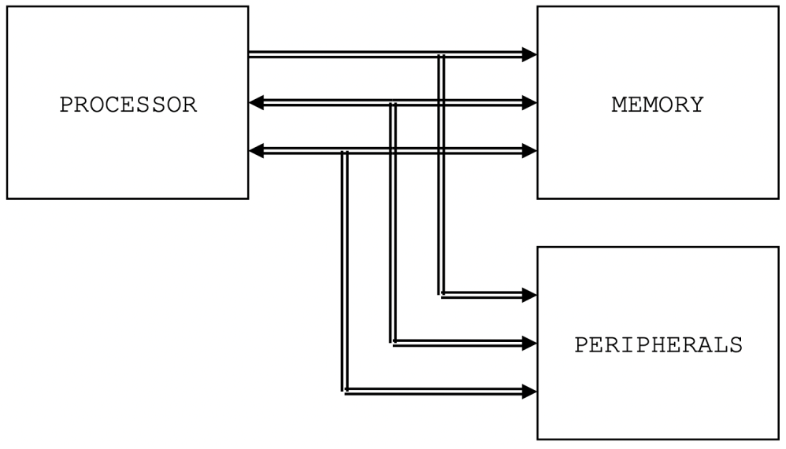
Basic Computer’s Structure
There are four main structural components:
Processor/ Central Processing Unit (CPU): controls the operation of the computer and performs data processing functions

Slide 10
Memory/ Main Memory: stores data (Volatile)
Peripherals: moves data between the computer and its external environment
System Interconnections: provide mechanism for communication among processor, memory and peripherals. A common example of system interconnection is a system bus

Slide 11
CPU
Major structural components of CPU are as follows:
Control Unit: controls the operation of the CPU and hence the computer
Arithmetic Logic Unit (ALU): performs the computer’s data processing functions
Registers: provides internal storage to the CPU
CPU Interconnection: provides a mechanism for communication among the control unit, ALU and registers

Slide 12
Main Memory
Main Memory consist of N cells, each of which can store 1 bit (either ‘0’ or ‘1’)
Volatile

Slide 13
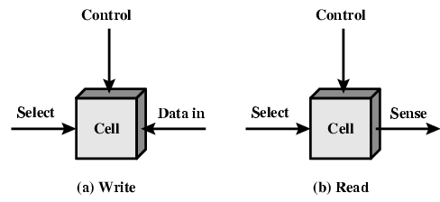
Memory Cell Operation
Each cell has three functional terminals

Slide 14
Select Terminal
To selects a memory cell for a read or write operation
Control Terminal
To indicate the required operation (read or write)
Data In/ Sense Terminal
For write, this terminal provides an electrical signal that sets the state of the cell to either ‘0’ or ‘1’
For read, this terminal is used to output cell’s state

Slide 15
Main Memory Logical Structure
100A
1014
1028
1008
1010
1020
1006
100C
1018
1004
1008
1010
1002
1004
1008
1000
1000
1000
16 Bit
32 Bit
64 Bit

Slide 16
System Interconnections: Bus
A bus is a communication pathway, connecting two or more devices
Typically, a bus consists of multiple communication pathways or lines
Each line is capable of transmitting signals representing binary ‘1’ and binary ‘0’

Slide 17
Buses can be classified as three functional groups:
Data or I/O Bus
Control Bus
Address Bus

Slide 18
Data or I/O Bus
It contains the content that have been read from the memory location or is to be written on the memory location
It is bidirectional, as CPU requires to send and receive the data
The word length of a CPU depends on data bus, that’s why Intel 8086 is called 16-bit microprocessor because it has 16-bit data bus

Slide 19
Control Bus
It is used for sending control signals (typically read or write) to the memory and I/O devices
The CPU sends control signals on the control bus to enable the outputs of addressed memory devices or I/O devices
It is unidirectional

Slide 20
Address Bus
It carries the address of memory location to be written on or to be read from
CPU uses address bus to send out the address of the memory location
It is unidirectional

Slide 21
Basic 8086 consists of 20-bit address bus
The memory locations that a microprocessor can access can be calculated as:
2^N (where N is the size of address bus in bits)
2^20 = 1,048,576 bytes or 1 Mb
So it can access up to 1 Mb memory locations

Slide 22
Program to Main Memory Mapping
Consider the following piece of main memory and code:
int a;
int *temp;
a = 2;
Temp = &a;
1014
1010
100C
1004
temp
1008
1004
2
a
1000
Main Memory

Slide 23
Question?
What will be the final value of ‘a’, that is stored in Main Memory?
a = 21
b = b - a
b = 7
a = 3
Main Memory
Notes:
Answer: 21

Slide 24
Video lecture can be accessed at
https://www.youtube.com/watch?v=nWKJHdXh9TI

